Slide 1
Valves

Slide 2
What type of valves can be used for throttling?
A throttling valve can open, close and regulate media flow. Throttling valves are regulator valves. Some people use the term “control valves” to mean throttling valves.

Slide 3
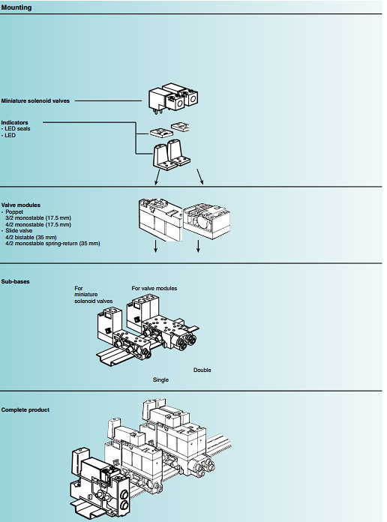
Electro-pneumatic miniature control valves

Slide 4
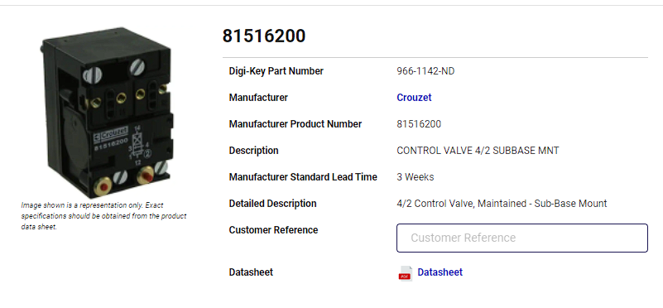
4/2 Control valve Module
Pneumatics products (crouzet-control.s3.amazonaws.com)

